Slide 1
Lecture No. 4
Electrochemistry
At the end of this lecture, students will be able to:
  Explain the construction and working of glass electrode
  Solve simple numerical problems on electrochemical cell

Slide 2
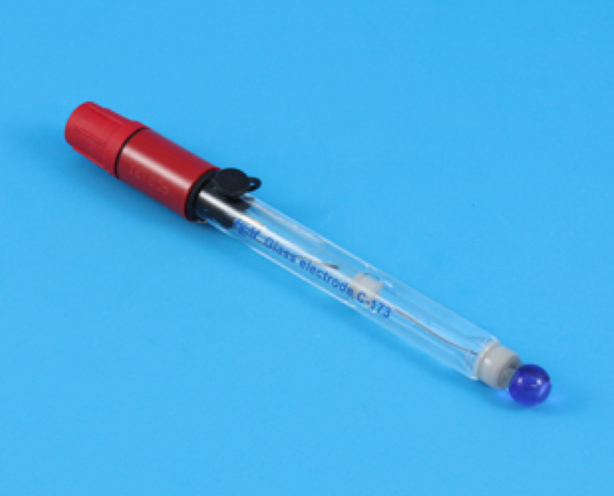
Ion-selective Electrodes –
Construction & Working of Glass Electrode
Electrodes that can selectively detect and quantitatively measure a particular chemical species and the potential produced will be corresponding to the variation of concentration of that species are called as ion-selective electrodes or membrane electrodes
Glass electrode – H⁺ ion sensitive
Fluoride ion sensitive electrodes, Chloride ion-sensitive electrodes, etc.

Slide 3
Construction & Working of Glass Electrode
Glass electrode is an H⁺ ion sensitive electrode, used for the determination of pH
Construction: A glass electrode consists of a long glass tube with a thin walled bulb of low M.P and high electrical conductance (Corning glass – 22% Na₂O, 6% CaO and 72% SiO₂)
Glass membrane bulb is sensitive to H⁺ ions up to pH 9
Bulb contains 0.1M HCl and a Ag-AgCl electrode (internal reference electrode), is immersed in a solution and connected by Pt wire for external contact
Glass electrode Representation:
Ag / AgCl (s) / 0.1M HCl / Glass// Test solution

Slide 4
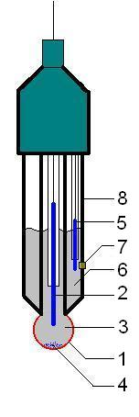
Construction & Working of Glass Electrode
A sensing part of electrode, a bulb made from a specific glass
Internal electrode, usually silver-silver chloride electrode
3. Internal solution, usually a pH=7 buffered solution of 0.1
mol/L HCl for pH electrodes
4. When using the silver chloride electrode, a small amount of
AgCl can precipitate inside the glass electrode
5. External reference electrode, usually the same type as 2
6. Reference internal solution, usually 0.1 mol/L KCl junction with analyte solution, usually made from ceramics or capillary with asbestos or quartz fiber
7. Junction with analyte
8. Body of electrode, made from non-conductive glass or plastics

Slide 5
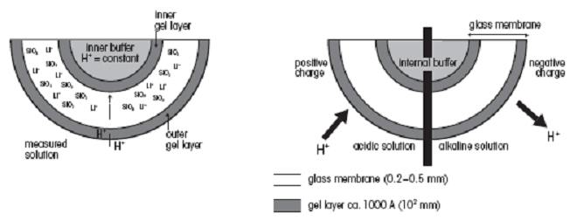
Construction & Working of Glass Electrode
Principle: This electrode selectively responds to specific ion in the solution and the potential developed at the electrode is the function of the concentration of that ion in the solution
The electrode generally consists of a membrane which is capable of exchanging the specific ions with the solution with which it is in contact
Glass Membrane
Reference Solution to Internal standard Reference
electrode 1 be analyzed solution electrode 2
(External) [H⁺]=c₁ [H⁺]=0.1M = c₂ (Internal)
E1 E2

Slide 6
Construction & Working of Glass Electrode
Membrane undergoes an ion exchange reaction, the Na⁺ ions on the glass are exchanged for H⁺ Ions
H⁺ + Na⁺Gl⁻  Na⁺ + H⁺Gl⁻
Boundary potential established due to the above reaction is due to glass electrode potential E_{G}
Glass electrode potential consists of three components;
E_{G} = E_{b} + E_{Ag-AgCl} + E _{asymmetric}
where E_{b} is the boundary potential, given by equation
E_{b} = E₁ − E₂ = 0.0591 log [C₁/ C₂]

Slide 7
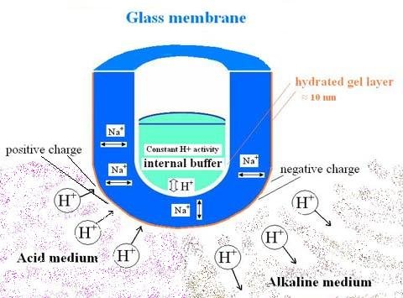
Construction & Working of Glass Electrode
Asymmetric potential arises due
to the difference in responses of
inner and outer surfaces of the
glass bulb to changes in H⁺
ion activity
This is a result of different strain on two curvatures
E_{G} = E_{Ag-AgCl} + E _{asymmetric} + 0.0591 log [C₁/ C₂]
Since C₂ is constant, C₁ = H⁺ (analyte)
E_{G} = E_{Ag-AgCl} + E _{asymmetric} + L − 0.0591 pH Where L = − 0.0591 log C₂
E_{G} = E_{G}⁰ − 0.0591 pH Where E_{G}⁰ = L + E_{Ag-AgCl} + E _{asymmetric}

Slide 8
Glass Electrode
Advantages:
Glass electrode can be employed in the presence of strong oxidizing and reducing substances and in aqueous solutions
Not poisoned easily
Used in un-buffered solution and can be adopted for measurements with small quantities of solutions
Simple to operate and can be used in portable instruments
It is unaffected by colored and turbid solutions

Slide 9
Glass Electrode
Disadvantages:
It imparts error in strong acidic and basic mediums
Cannot be used in non aqueous solutions (like pure alcohol and some organic solvents)
Due to high resistance of the glass membrane, expensive electronic voltmeters are to be used for measurements
Applications: Glass electrodes are commonly used for pH measurements – in pure research, controlling of industrial processes, analyzing foods, cosmetics and comparison of indicators of the environment and environmental regulations: a microelectrode measurements of membrane, electrical potential of a biological cell, analysis of soil acidity, etc.

Slide 10
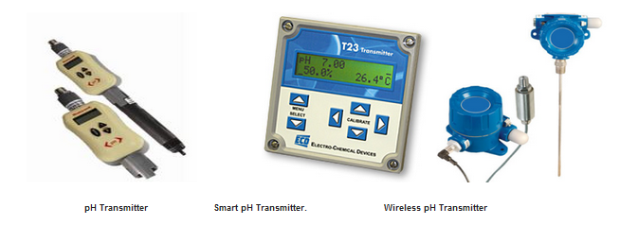
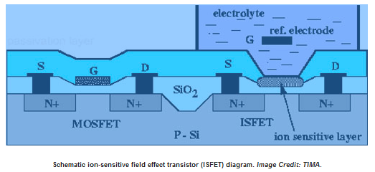
Applications
Ion sensitive field effect transistor uses
silicon chips (Stable) instead of glass

Slide 11
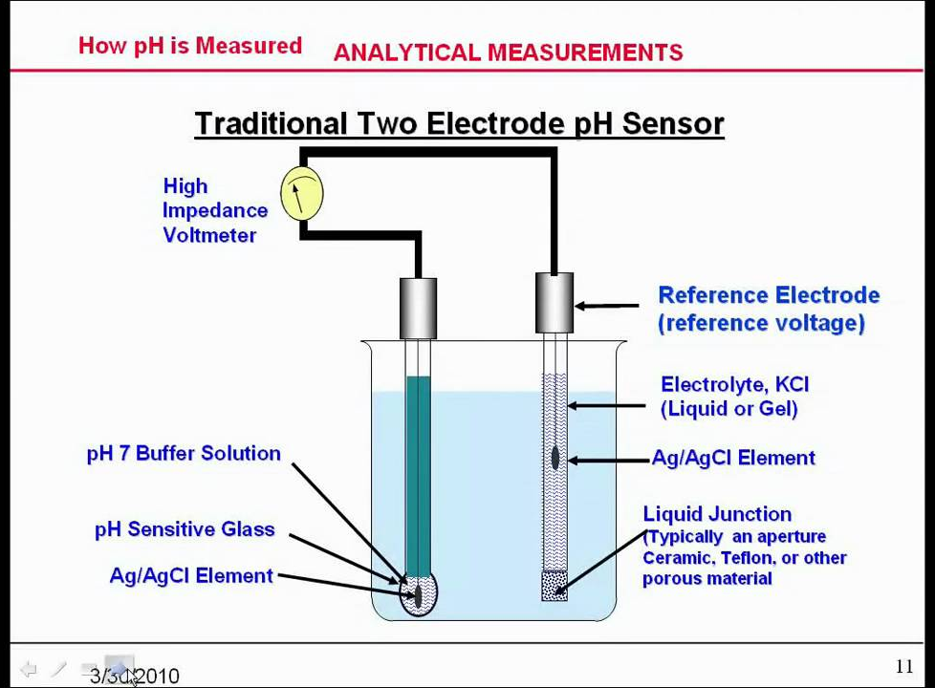
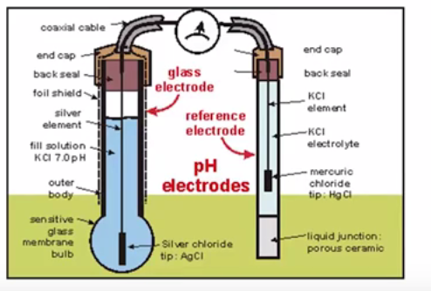
Measurement of pH using Glass Electrode
A glass electrode is immersed in a solution, along with calomel electrode as a external reference electrode, whose pH is to be determined
Cell Representation
Ag / AgCl / Cl⁻ / Unknown Solution / glass / 0.1M HCl / AgCl /Ag

Slide 12
Measurement of pH using Glass Electrode
Potential of glass electrode depends on the pH of the solution into which it is dipped
Glass electrode is combined with calomel electrode and is immersed into the solution
Electrodes are connected to potentiometer and cell potential is measured E_{cell} = E_{G} – E _{Ag/AgCl}
E_{cell} = E_{G}⁰ – 0.0591 pH - E _{Ag/AgCl}
at 25°C

Slide 13
Numerical
  A cell is constructed using Cd⏐Cd²⁺ (0.50 M) and Mn⏐Mn²⁺ (0.02 M) electrodes. Represent the cell and write electrode reactions, cell reaction and calculate the cell potential at 27°C.
  Given, = − 0.403 V and = −1.18 V. Ans: 0.8186V
  2. A zinc rod immersed in Zn(NO₃)₂ (0.080 M) is coupled with silver rod immersed in AgNO₃ (0.005 M) to form a cell. Represent the cell, and calculate the cell potential at 25°C if the standard electrode potentials of zinc and silver are − 0.76 V and 0.80 V respectively. Assume the degree of dissociation of Zn(NO₃)₂ and AgNO₃ to be 0.85 and 0.91 respectively. Ans: 1.456 V

Slide 14
Electrode Potential and cells
Numerical:
3. Calculate the emf of the following concentration cell at 298 K. Ag⏐Ag⁺ (0.002M)⏐⏐ Ag⁺(0.25M)⏐Ag. Also, calculate the cell potential, when the concentration of silver ions in the above cell is changed from 0.002 to 0.001M at same temperature.
Ans1: 0.1239V, Ans2: 0.1417V
4. Calculate the potential of the cell formed by the coupling of two copper electrodes immersed in cupric sulphate solutions at 27°C. Concentration of cupric ions in one electrode system is 20 times more concentrated than the other. Ans: 0.387V

Slide 15
Electrode Potential and cells
  5. Calculate the potential of the following cell at 298K
  Pt / I_{2 ,}I⁻ (0.03M) // Fe³⁺ (0.1M) / Fe
Given and
Ans: 0.221V
6. Calculate the concentration of Zinc sulphate solution at Zn cathode when at anode a Zn rod is dipped in 0.051M zinc sulphate solution. The potential of the cell is 0. 042V.
Ans: 1.3455M

Slide 16
Electrode Potential and cells
Represent the cell, write electrode and cell reaction for Zn-Ag cell. At 298K the standard electrode potential of Ag was 0.80V and Zn was – 0 .76V with concentrations of Ag⁺ and Zn²⁺ ions were 5.2 × 10⁻⁶M and 1.3 × 10⁻³M respectively. Calculate the change in free energy for the reduction of 1 mole of Ag⁺ ions.
A concentration cell was constructed by immersing two silver electrodes in 0.01M and 10M AgNO₃ solutions. Write cell reaction and calculate the emf of the concentration cell.

Slide 17
Electrode Potential and cells
9. A concentration cell is constructed by dipping two copper electrodes in 0.001M and 0.1M CuSO₄ and the two solutions are connected by a salt bridge. Calculate the emf of the cell at 298K.
10. Calculate the standard electrode potential of Copper electrode (E⁰_{Cu2+/Cu}), if it’s electrode potential at 25°C is 0.296V when the concentration of Cu²⁺ ions is 0.015M.

Slide 18
Summary
  Principle of ion selective electrodes : Electrodes that can selectively detect and quantitatively measure a particular chemical species and the potential produced will be corresponding to the variation of concentration of that species
  Construction & working of Glass electrode
  Ag / AgCl (s) / 0.1M HCl / Glass// Test solution
  Numerical related to electrode potential

Slide 19
Additional Numerical to solve at home:
  1. To obtain a potential of 0.77V for an application, a cell formed by coupling an iron rod dipped in ferrous sulphate and a manganese rod dipped in manganese sulphate with the concentration of ferrous sulphate solution being 1.5M. Search the literature for standard potentials of Fe²⁺/Fe and Mn²⁺/Mn and arrive at a solution to find the concentration of manganese sulphate solution?
Ans: 0.1442 M

Slide 20
Additional Numerical to solve at home:
  2. Suggest a suitable temperature to obtain a potential of 0.00765V for an application when a concentration cell has zinc rods dipped in 0.04M and 0.07M zinc sulphate solutions.
  Ans: 317.3°C

Slide 21
Additional Problems to be done at Home
3. The E⁰ values of Li/Li⁺, Zn/Zn²⁺, Cu/Cu²⁺ and Ag/Ag⁺ are – 3.0V, – 0.76V, + 0.33V and 0.80V respectively. Which combination of the electrodes you use to construct a cell of highest emf if the ionic concentrations are 0.1M, 1.0M, 10M and 0.01M in the same order. Justify your answer.

